Slide 1
Forecasting PM2.5 Pollution Using Weather Data
Jack Seagrist & Karthik Ramesh

Slide 2
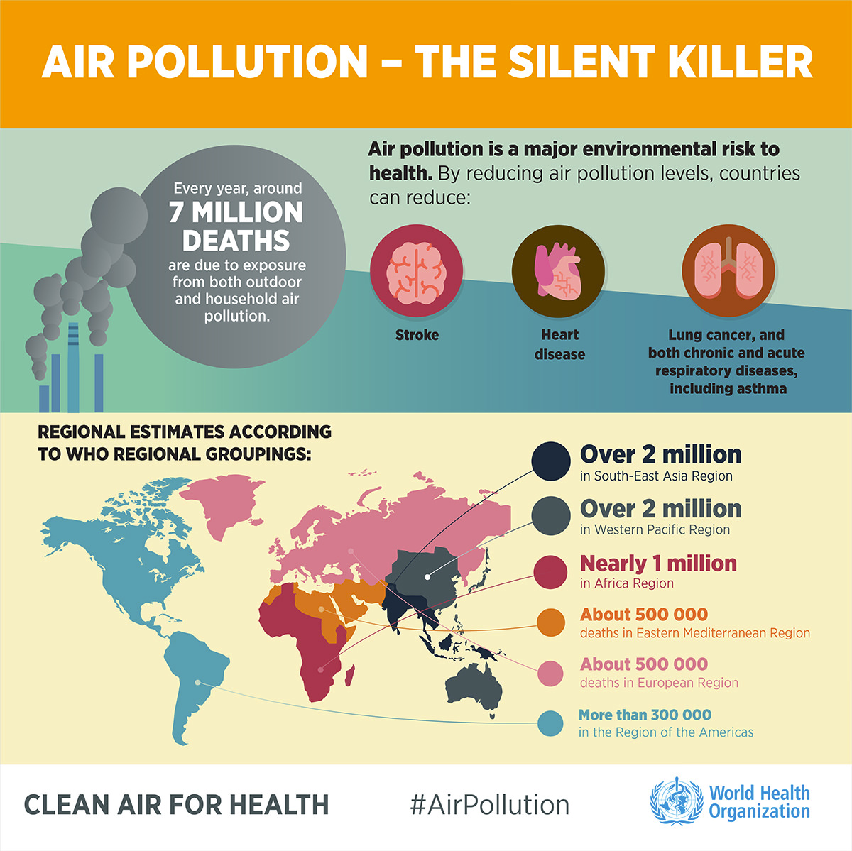
INTRODUCTION
Problem: Air pollution related illnesses causes 7 million deaths and cost the global economy $225 billion annually (World Bank)
PM2.5
Proposed Solution: Data-driven air quality forecasting for effective policy-making
Why?: Cost effective and predictions at higher spatial and temporal resolution
(Source: Solar Impulse Foundation)

Slide 3
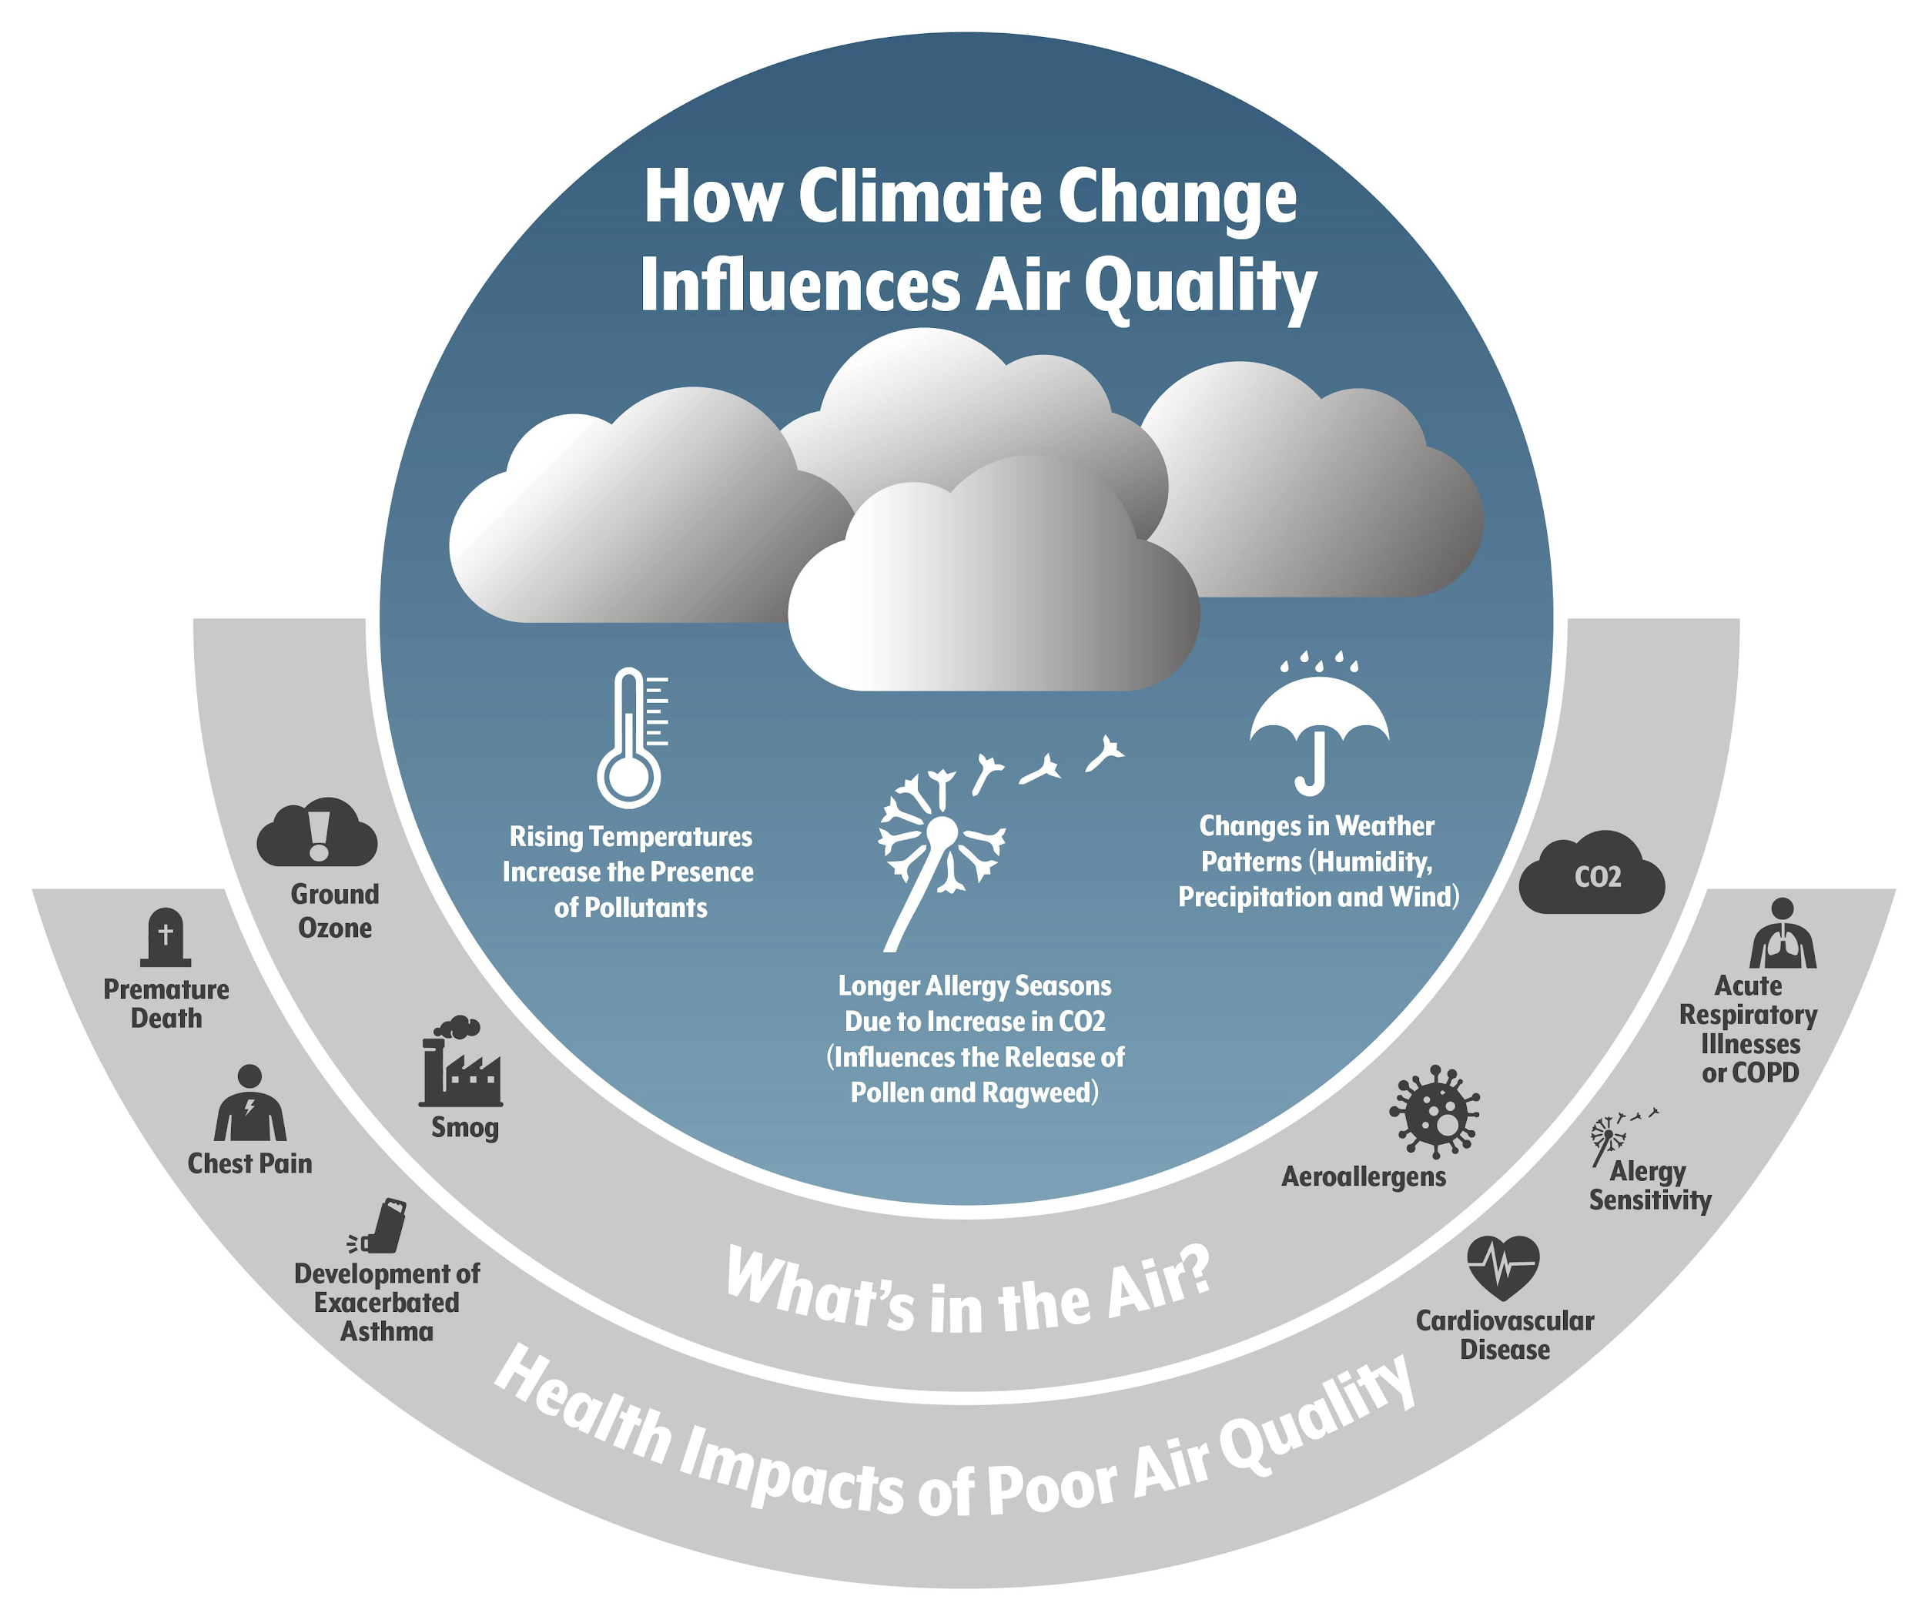
NEURAL NETWORK TO FORECAST AIR QUALITY
Meteorological parameters are closely linked with particulate matter levels - important for dispersion and dilution.
Parameters like Relative Humidity, Air temperature, Air pressure, Wind Speed, Wind Run, Precipitation.
Weather data | CIMIS
PM2.5 data | EPA
(Source: Colorado Health Institute)

Slide 4
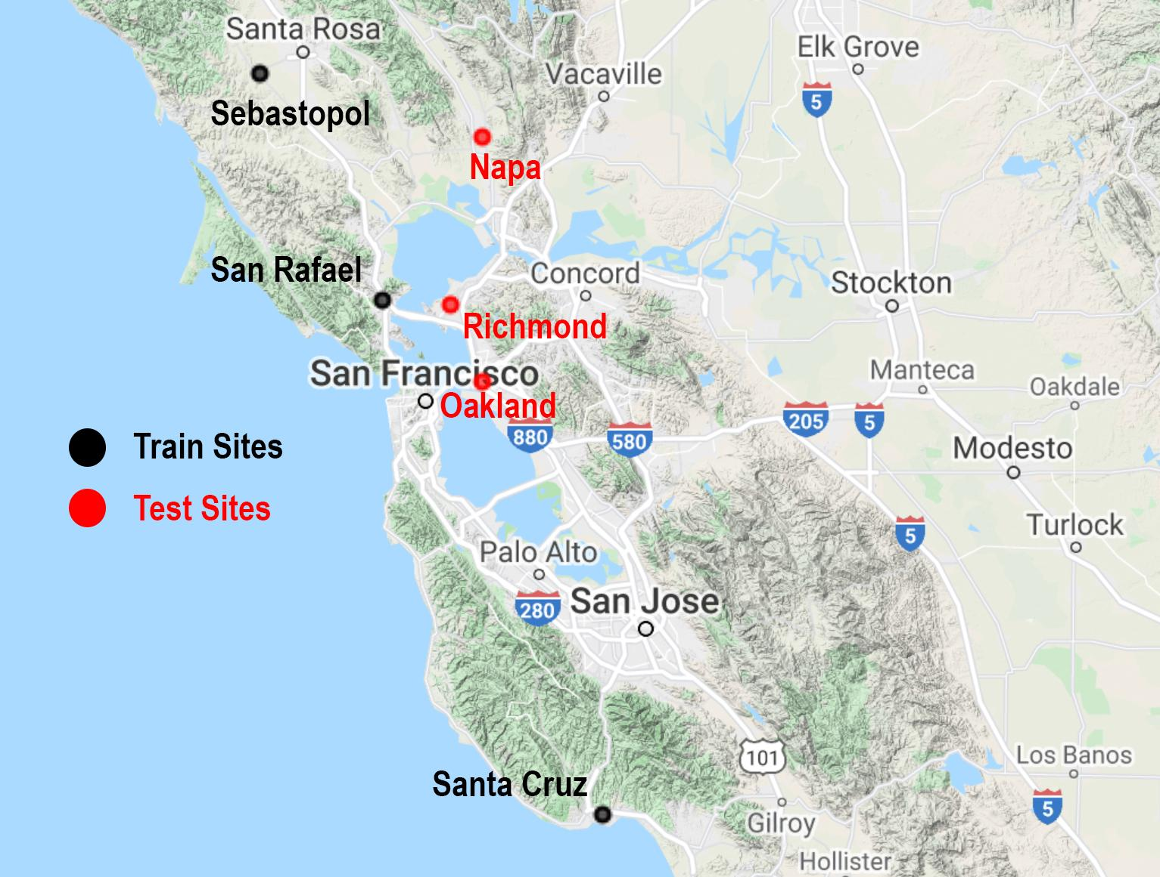
TRAIN AND TEST SAMPLES
Train Data (2015-2019)
Test Sites
1. | Sebastopol
2. | San Rafael
3. | Santa Cruz
1. | Oakland
2. | Richmond
3. | Napa
(Created using Google Earth Engine)

Slide 5
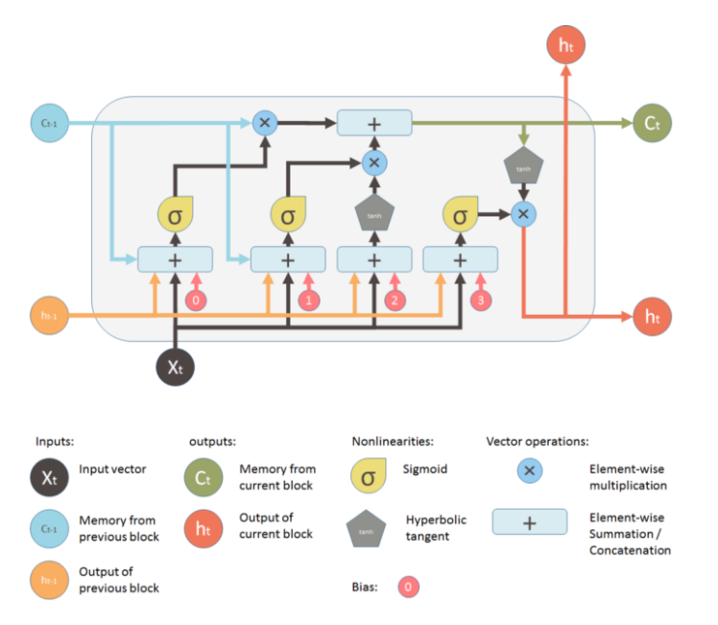
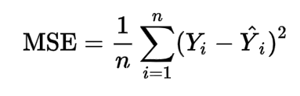
Methods
Network Architecture
Loss Function
(Source: statisticshowto.com)
(Source: medium.com)
Notes:
LSTM - https://medium.com/mlreview/understanding-lstm-and-its-diagrams-37e2f46f1714
Mean Squared Error - https://www.google.com/search?q=mean+squared+error+formula&rlz=1C1CHBF_enUS841US841&oq=mean+squared&aqs=chrome.0.69i59j0i67i433i457j69i57j0l4j69i60.3491j1j4&sourceid=chrome&ie=UTF-8

Slide 6
Experiment
Model Version | Key Features
Version 1 | 1 layer; 50 neurons; loss=mean absolute error; dropout=.3
Version 2 | 1 layer; 100 neurons; loss=mean absolute error; dropout=.4
Version 3 | 2 layers; 50 neurons/layer; loss=mean squared error; dropout=.4
Version 4 | 3 layers; 100 neurons/layer; loss=mean squared error; dropout=.4

Slide 7
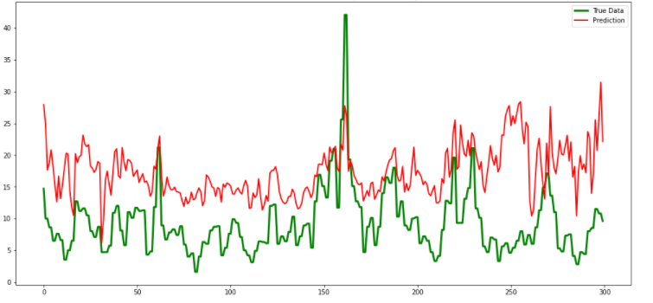
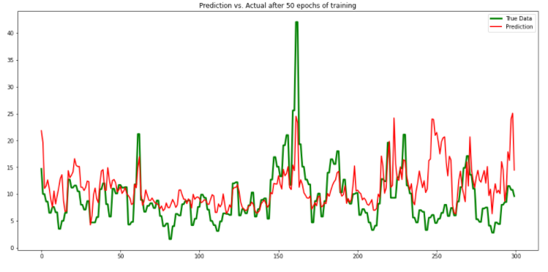
Results
Model Version | RMSE
Version 1 | 6.990
Version 2 | 6.060
Version 3 | 5.380
Version 4 | 3.696
Oakland Prediction with model version 2
Oakland Prediction with model version 4

Slide 8
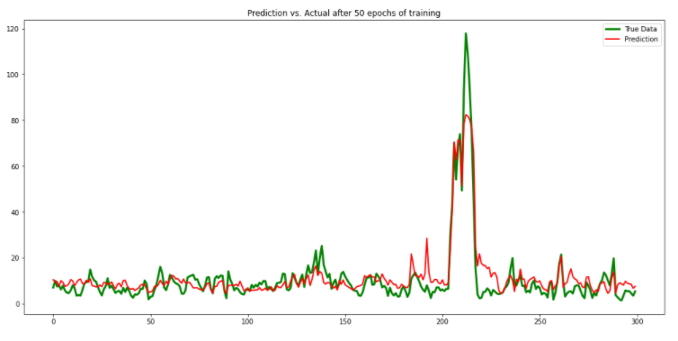
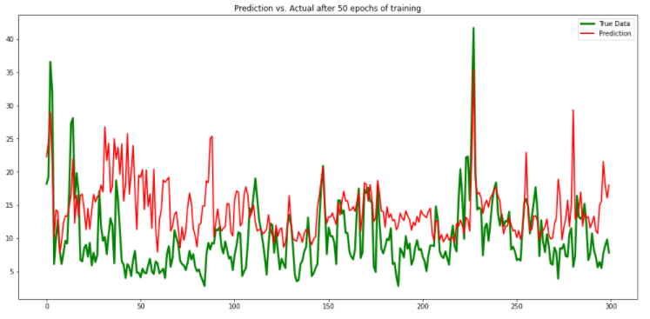
Results
Napa Prediction with model version 4
Richmond Prediction with model version 4

Slide 9
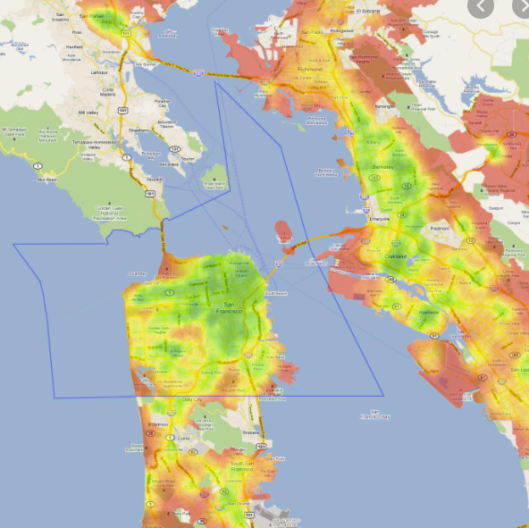
Future Work
Improve model prediction accuracy with:
Expand data set
Deeper network
Emission source data
Develop prediction map
(Source: maps-san-francisco.com)

